Slide 1
Return of the Table
Michael Vitrano and Jared Pochtar
4115 Final Project
Professor Stephen Edwards

Slide 2
Problem Area
Working with relational databases can be difficult using traditional SQL queries, which makes querying certain subsets of data difficult
Additionally, learning certain statistics about a dataset can be impossible to do solely in SQL
The traditional way of computing these statistics is to issue queries to the database, parse the information through a database driver and use a second language to compute statistics

Slide 3
RT’s Solution
Relational tables and records become first-class language objects
Driver for interfacing with database is built-in to the language
Filter, Join and Map operations allow the programmer to easily create any composite dataset from the original database or filter to any subset of the original database
Reporting generated datasets in a neat and organized fashion is easy
Committing data to the database is also easy!

Slide 4
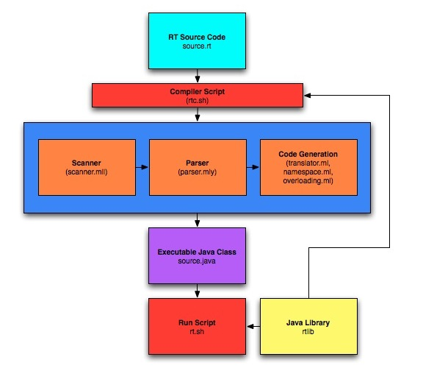
Translator Design
RT code is translated into Java source code and automatically compiled to .class files
rtc.sh and rt.sh are scripts that manage compiling and running RT programs respectively
rtc, the RT translator, is written in OCaml and is responsible for Scanning, Parsing, Semantic Analysis and Code Generation
Generated Java source is linked against RTLib, which provides the framework for all table related features

Slide 5
Demonstration
Problem:
Business has information regarding customer purchases in their database and want to know who are their best customers
Also want to know which store location and item sold are the most popular
Steps:
Join customer, item, store and purchase data
Calculate each customer’s total amount purchased, favorite store, amount spent at that store, favorite item and the amount spent on that item
Sort customers based on total amount purchased
Display results and commit to database

Slide 6
Lessons Learned
Quit talking about the project and just start writing code
Work with people who you trust to do work on time and correctly
Divide the project into separate units and assign each to a team member, make sure everyone knows how the parts interface
SVN is a necessity, but can cause headaches if you’re lazy about using it

Slide 7
Advice to Future Groups
Start early, this can not be stressed enough
This is an iterative process and must be done steps at a time. It is impossible to do all at once
Pick an end point to your project and stick to it
Test cases are important for two reasons, they both make sure you’re doing it right and keep you focused on what the language is trying to do
Choose a problem area that interests you

